Slide 1
P242 Group 3
NLP
Emails

Slide 2
Group
Members
Mrs. Neha Nikhil Khandve
Mr. Shubham Tanawade
Mr. Namadev Gurappa Hosatti
Mr Ravi Prasad
Ms. Shraddha Alka Sanjay Chougule
Mr Rashik Sharma
Mr Mohammed Siyad K P
02

Slide 3
Business Objective
Inappropriate emails would demotivates and spoil the positive environment that would lead to more attrition rate and low productivity and Inappropriate emails could be on form of bullying, racism, sexual favoritism and hate in the gender or culture, in today’s world so dominated by email no organization is immune to these hate emails.
The goal of the project is to identify such emails in the given day based on the above inappropriate content.
03

Slide 4
Project Phases
phase 1
phase 2
phase 3
phase 4
phase 5
phase 6
EDA and preprocessing
Feature Extraction
Building Prediction Models
Train, Test, Validate the Model
Evaluation of Model
Model Deployment
04

Slide 5
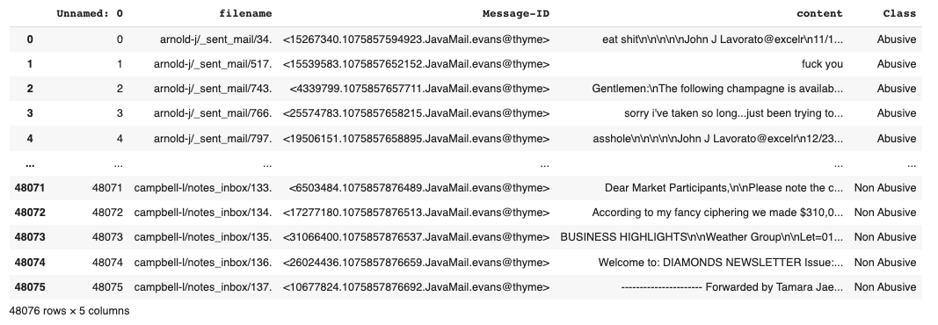
Dataset Details
Rows - 48076
Columns - 5
05

Slide 6
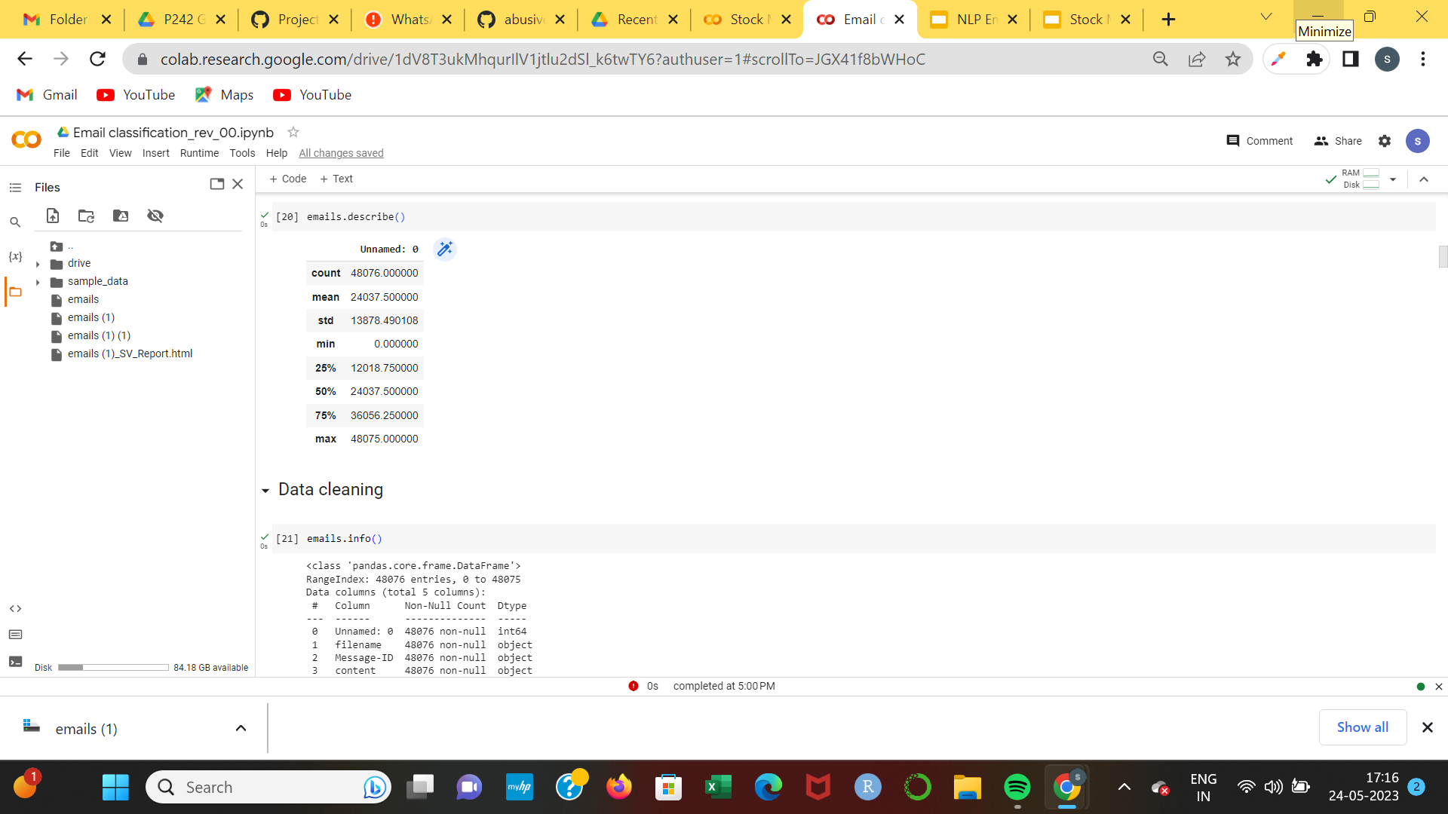
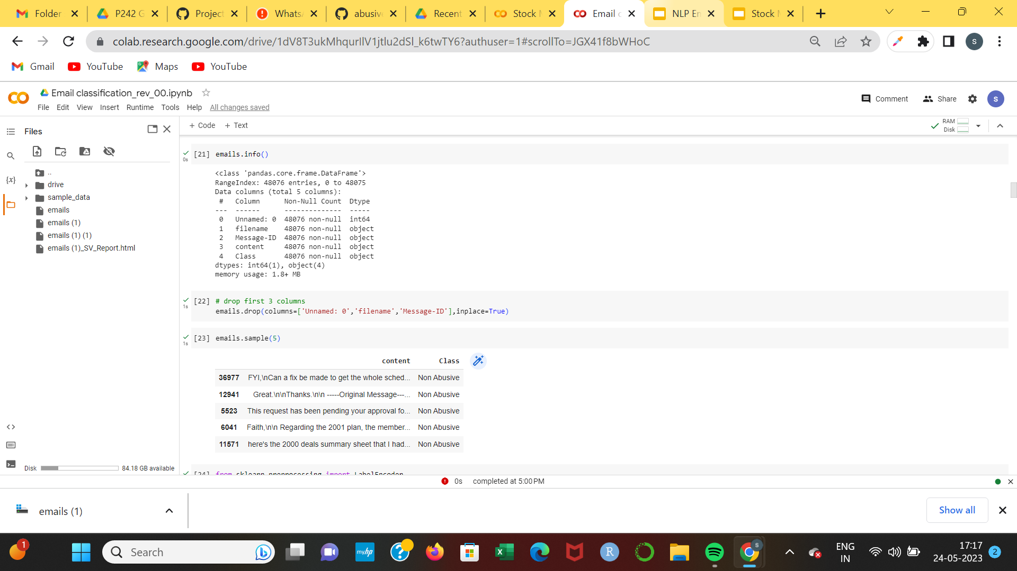
Exploratory Data Analysis
06

Slide 7
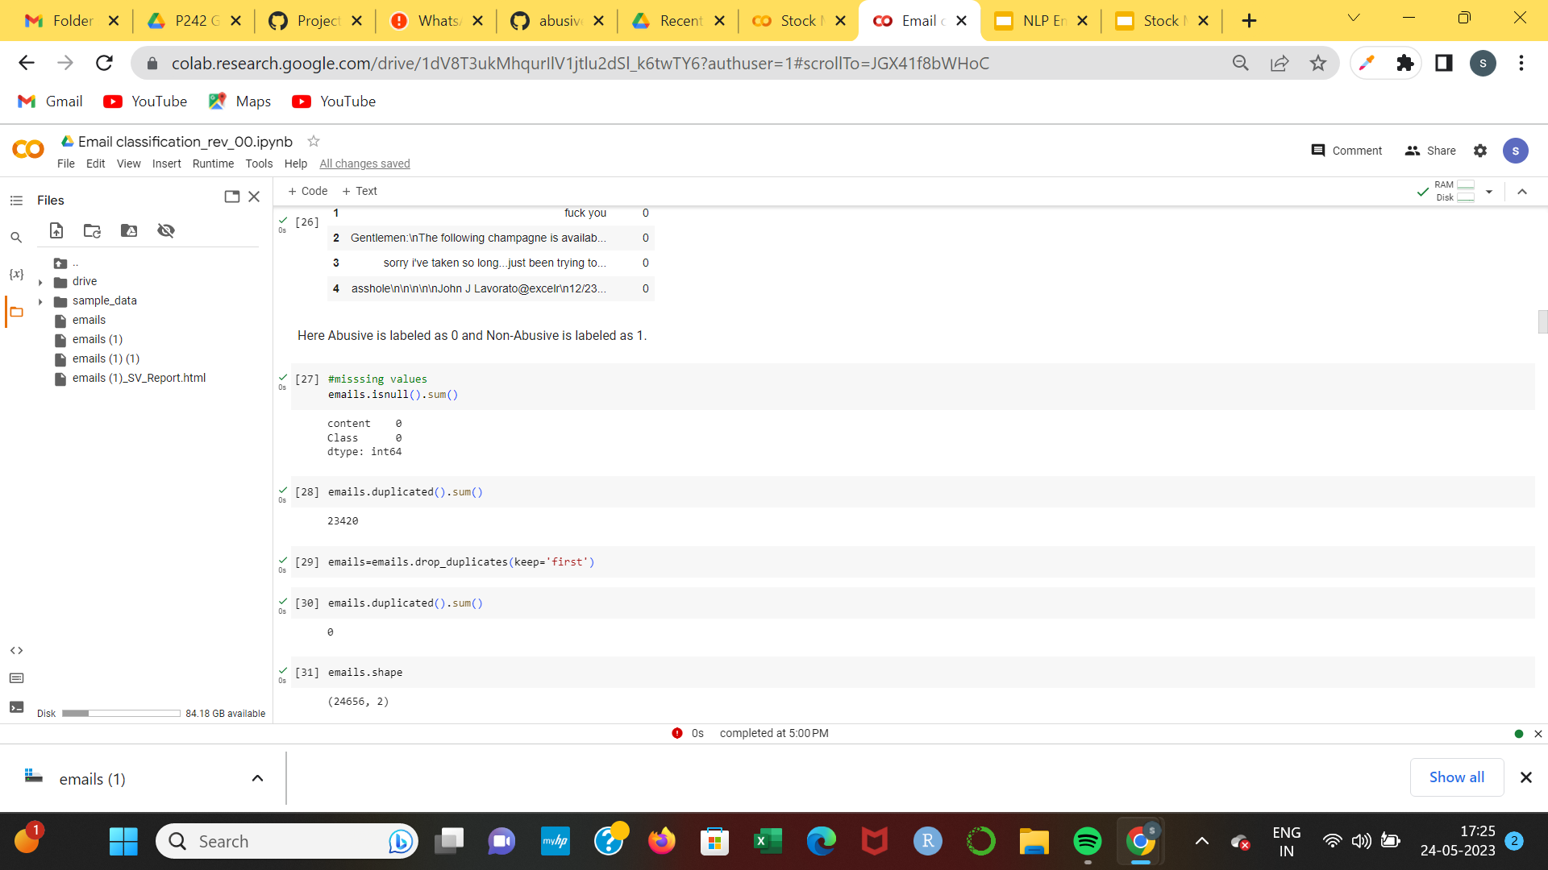
EDA (Dropping null and duplicate values)
06

Slide 8
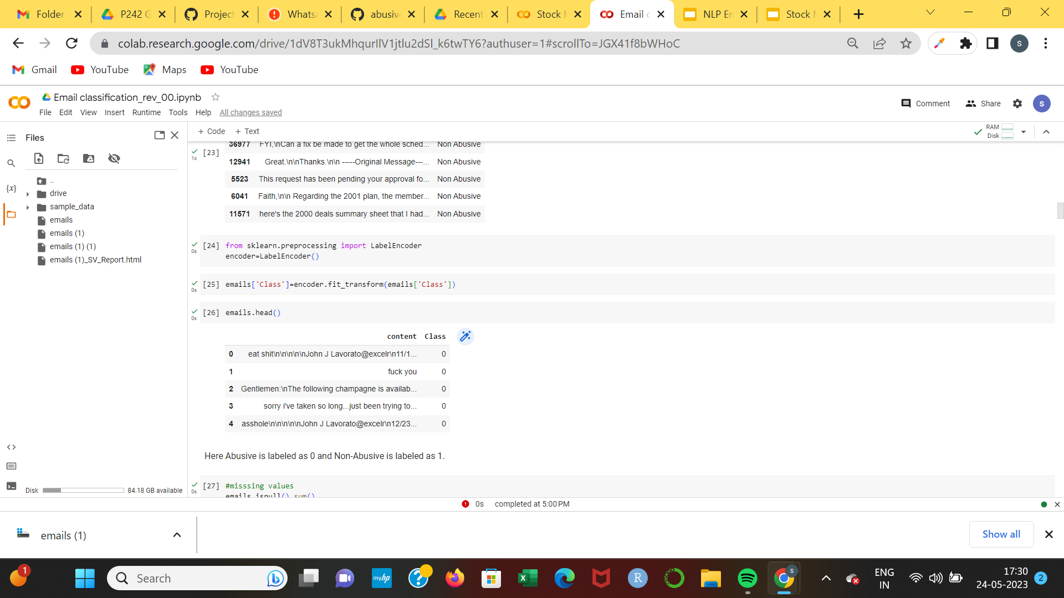
Label Encoding
Here, Abusive is labeled as 0 and Non-Abusive is labeled as 1
06

Slide 9
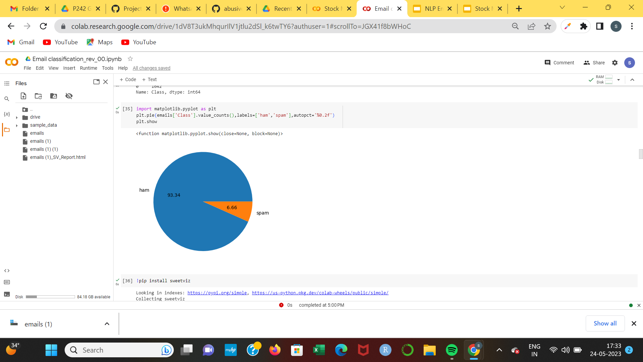
Pie chart for Ham & Spam count
06

Slide 10
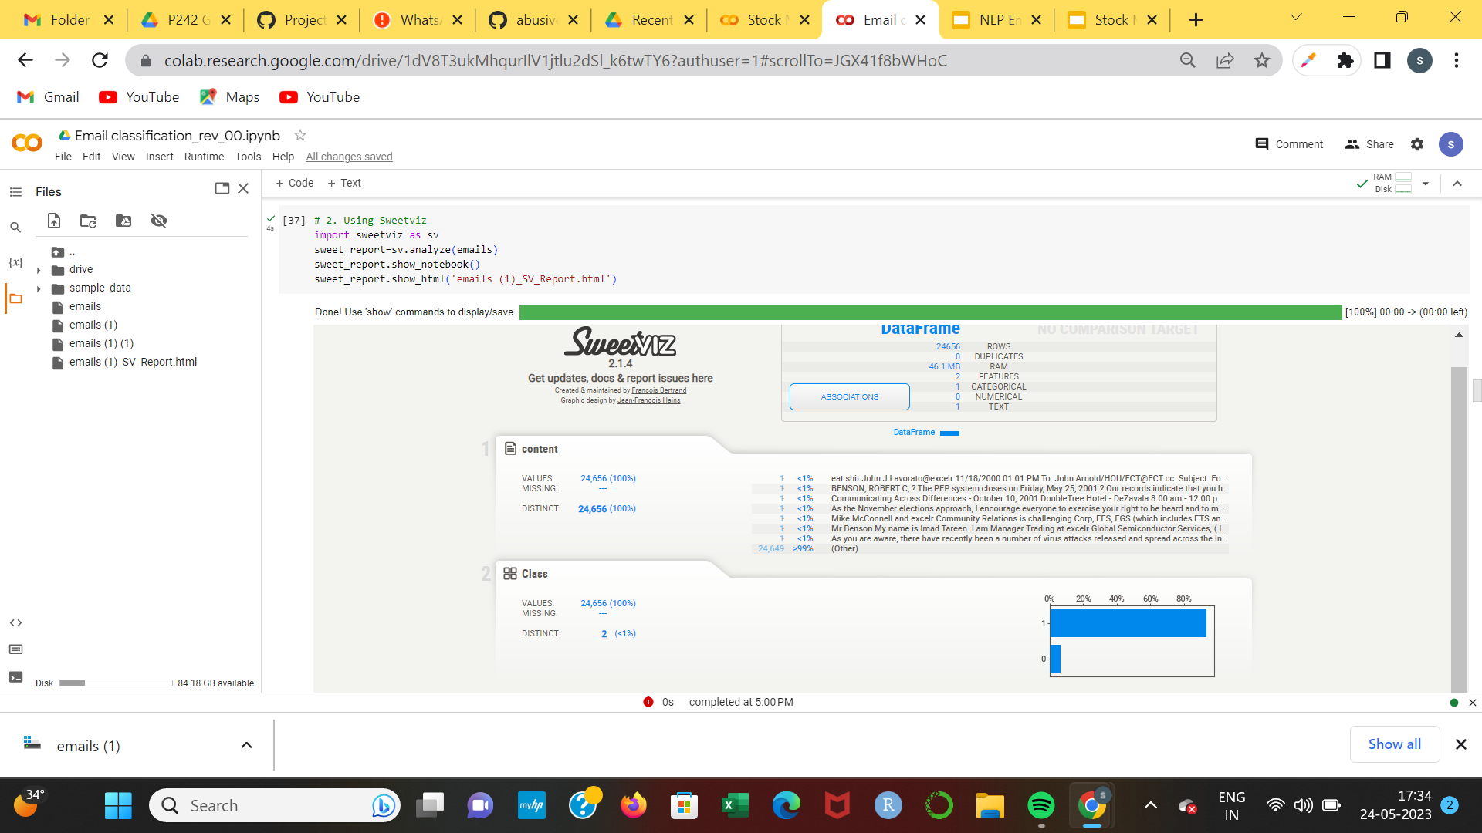
Auto EDA Report
Sweetwiz Report
06

Slide 11
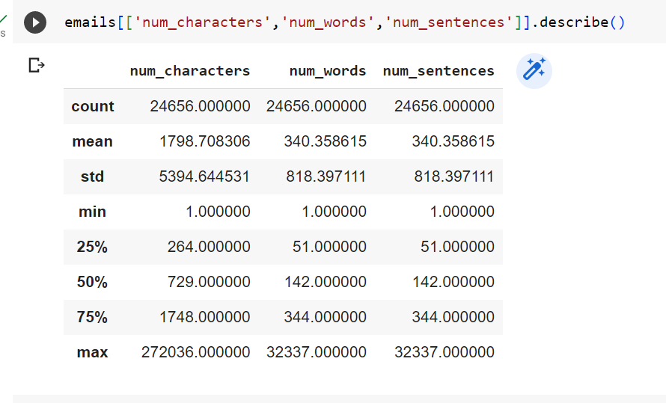
Length of Messages
06

Slide 12
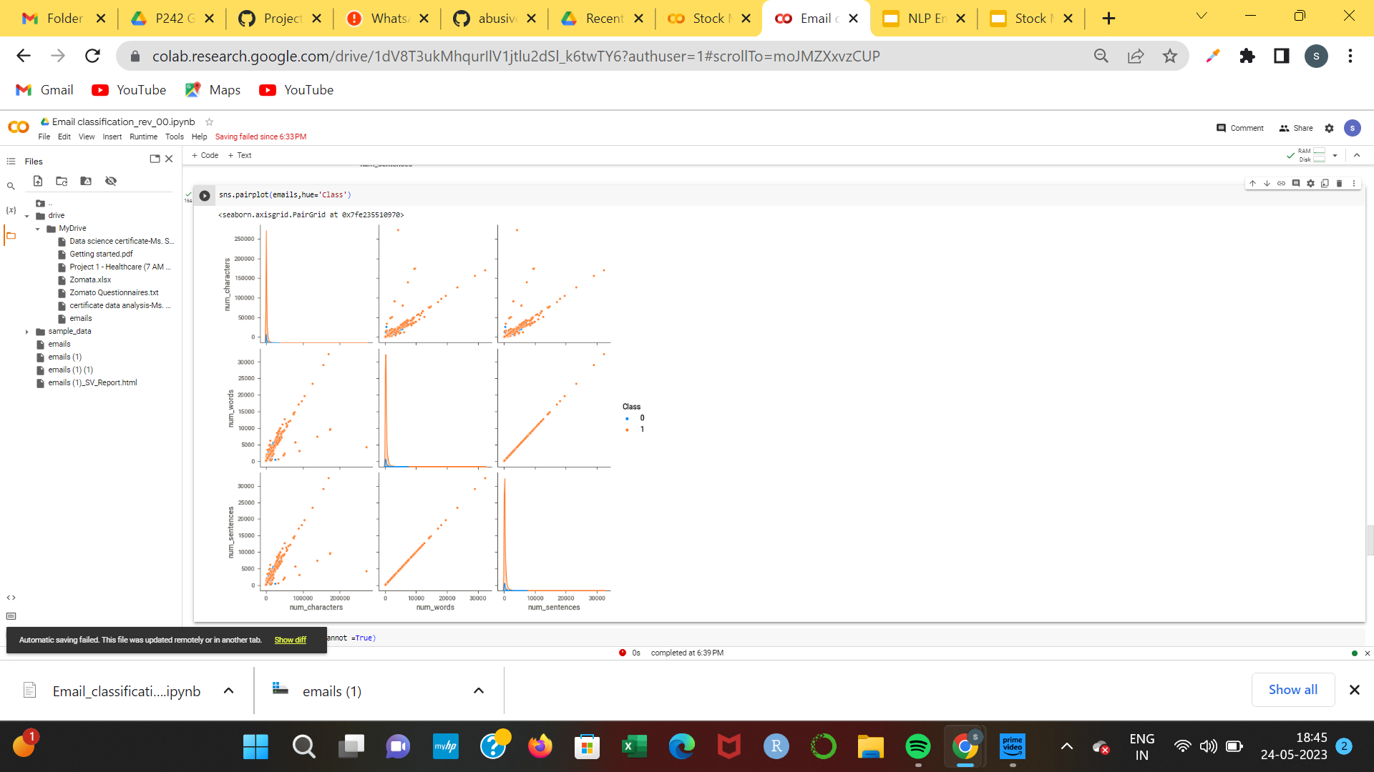
Pairplot for Emails
06

Slide 13
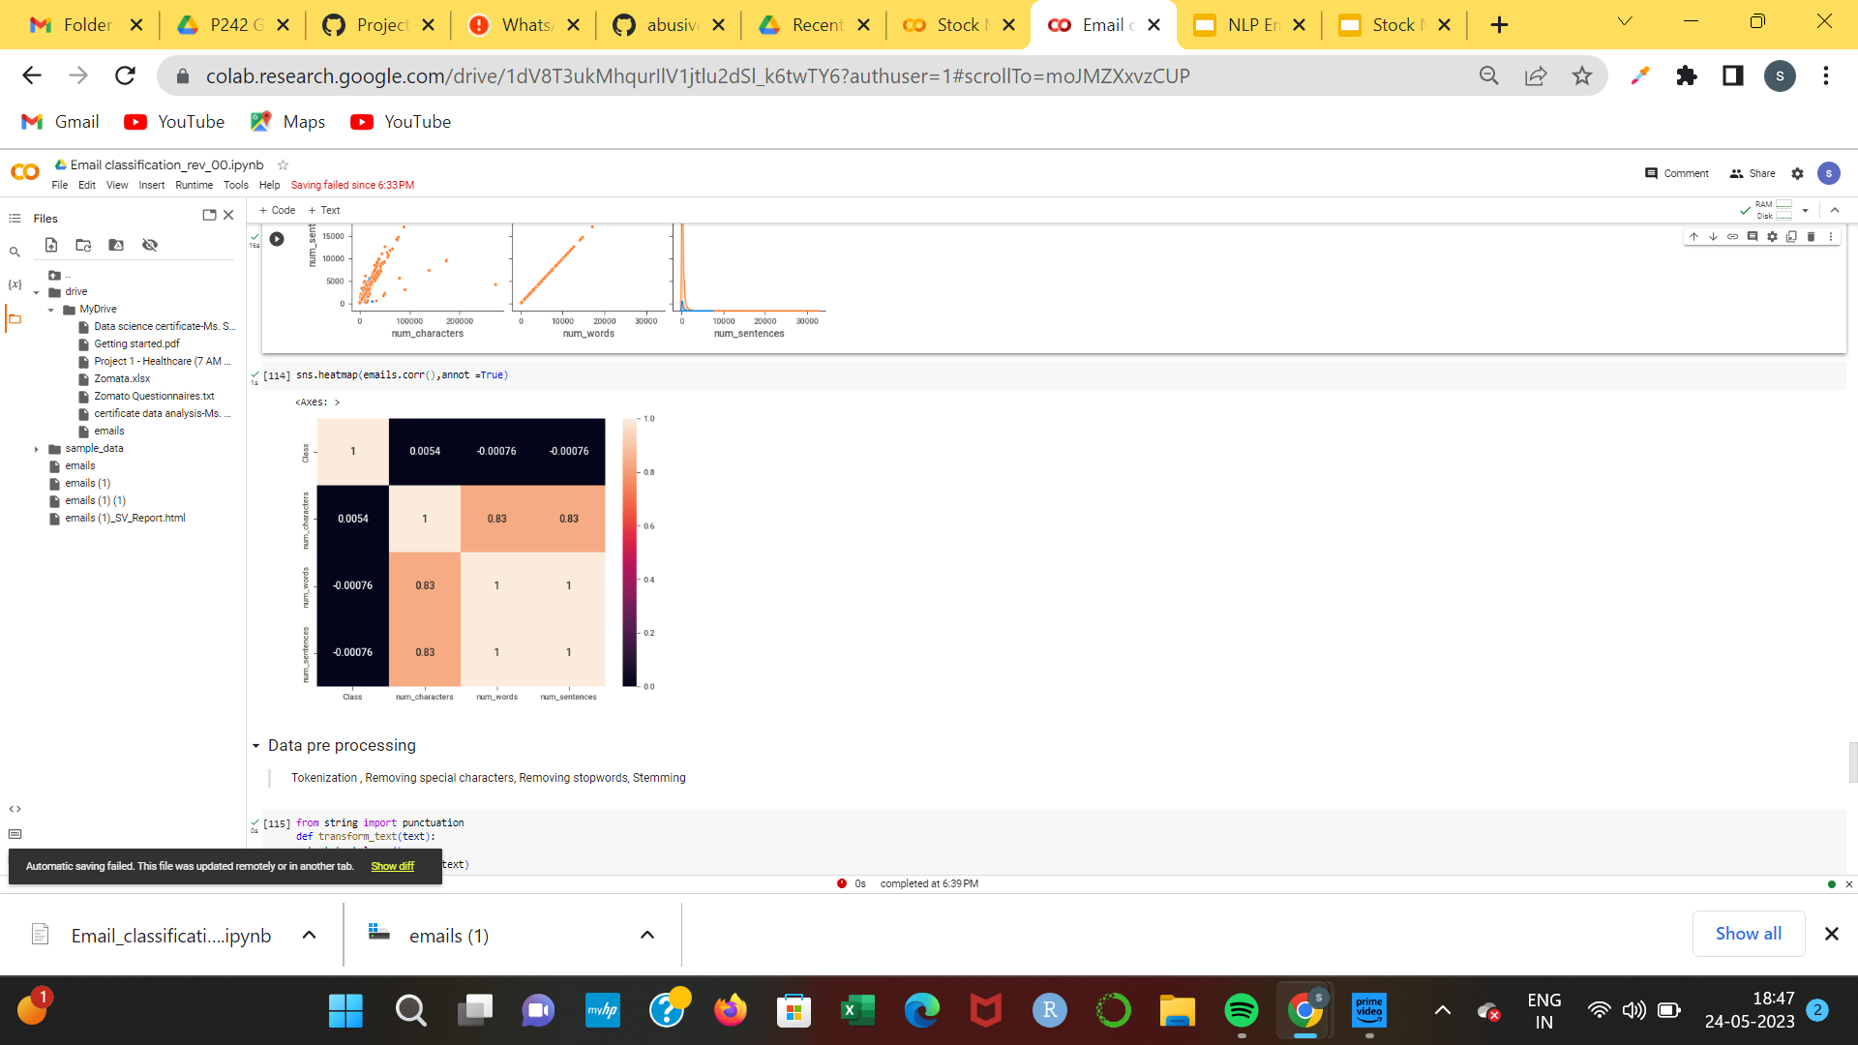
Correlation
By observing pairplot and heat map, we see that num words and num sentences are highly correlated.
06

Slide 14
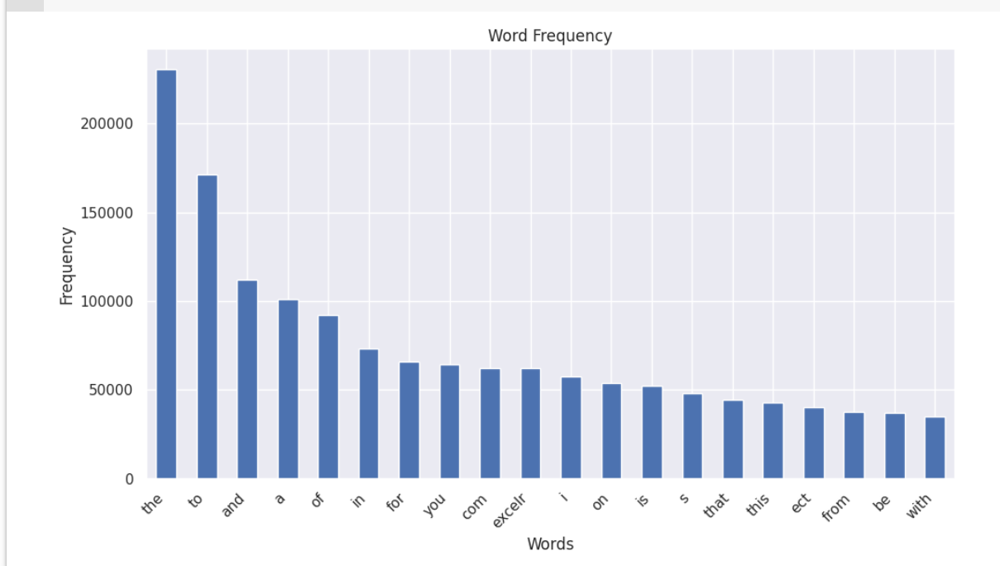
Data Cleaning
words frequency before removing stopwords
06

Slide 15
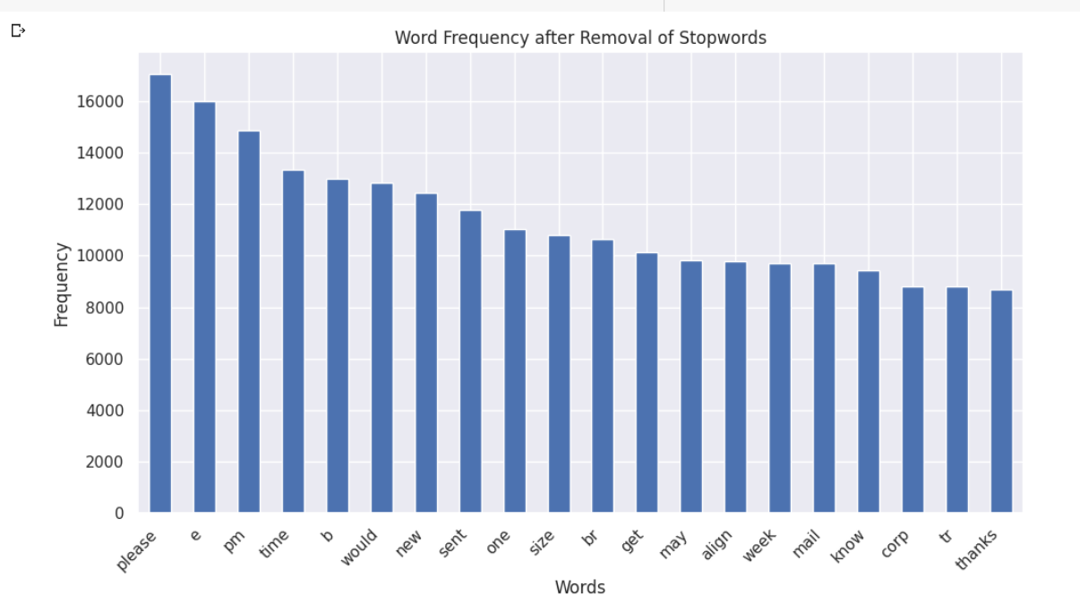
words frequency after removing stopwords
06

Slide 16
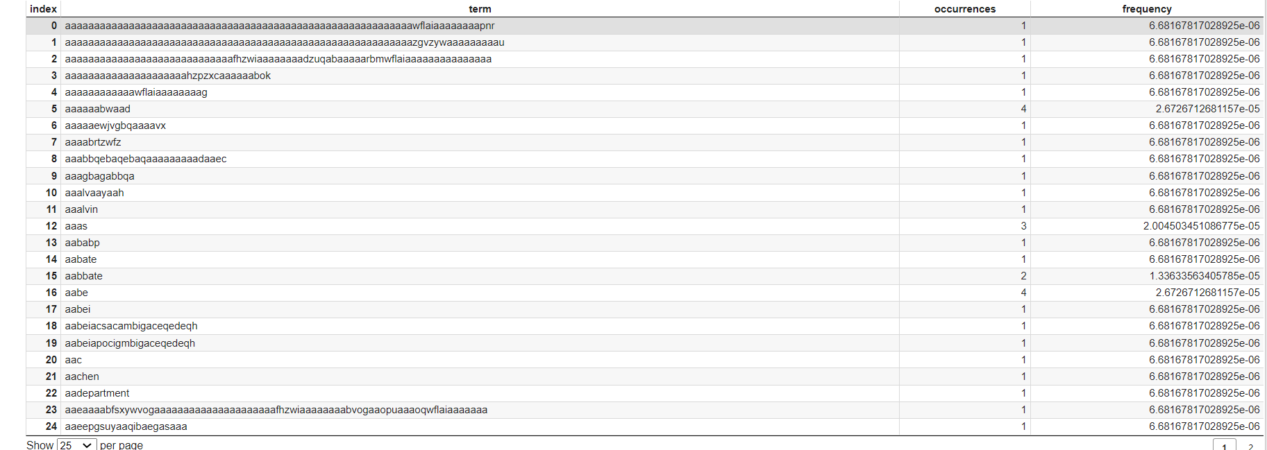
Feature extraction
#1 Countvectorizer: CountVectorizer is used to convert a collection of text
documents to a vector of term/token counts.
06

Slide 17
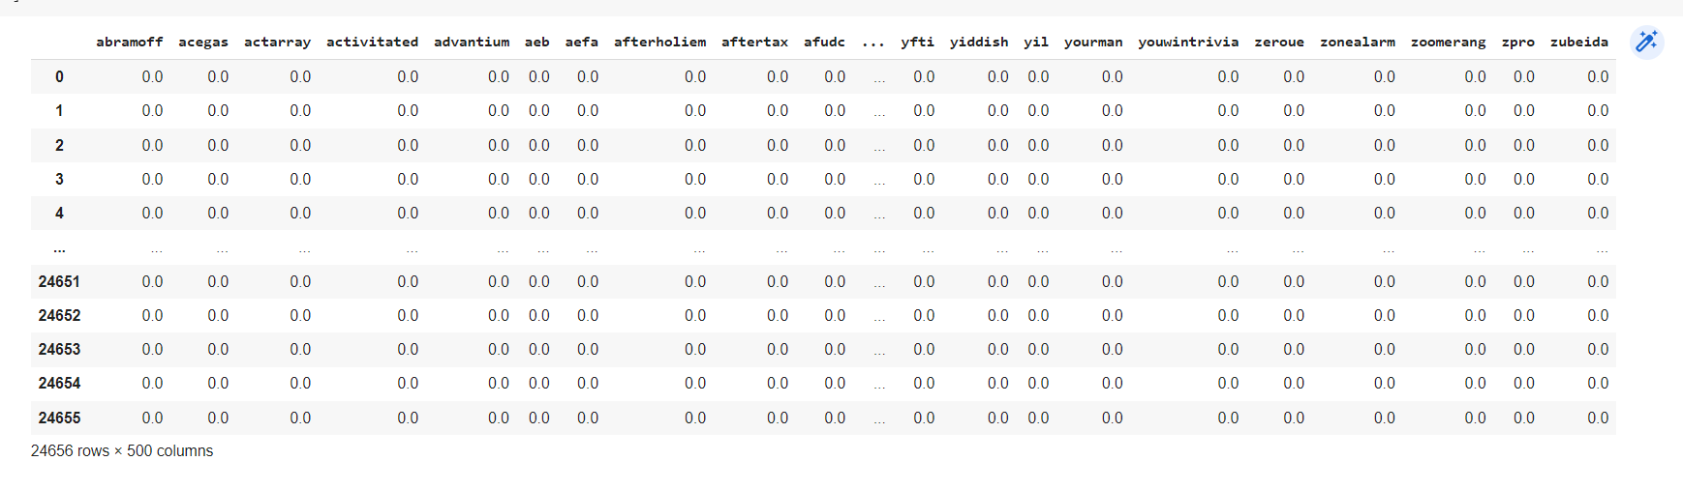
Feature extraction
#2TFIDF(Term frequency inverse document frequency) vectorizer:The TF-IDF Vectorizer converts a collection of raw documents into a matrix of TF-IDF features
06

Slide 18
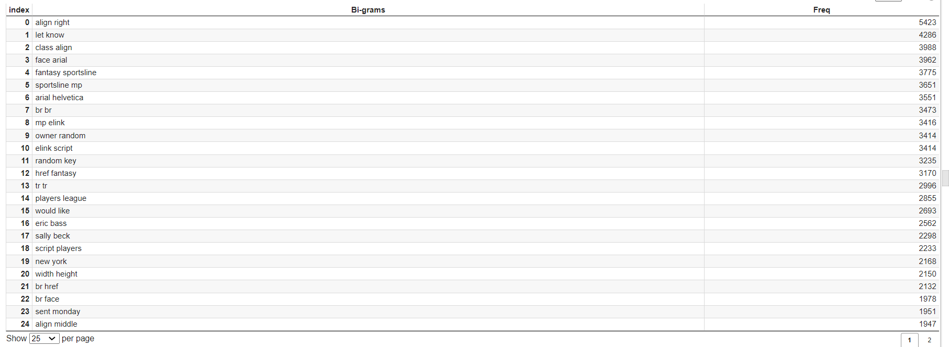
Feature extraction
#3 N-Gram: N-grams are used in the various use cases of NLP, such as spelling correction, machine translation, language models, semantic feature extraction
06

Slide 19
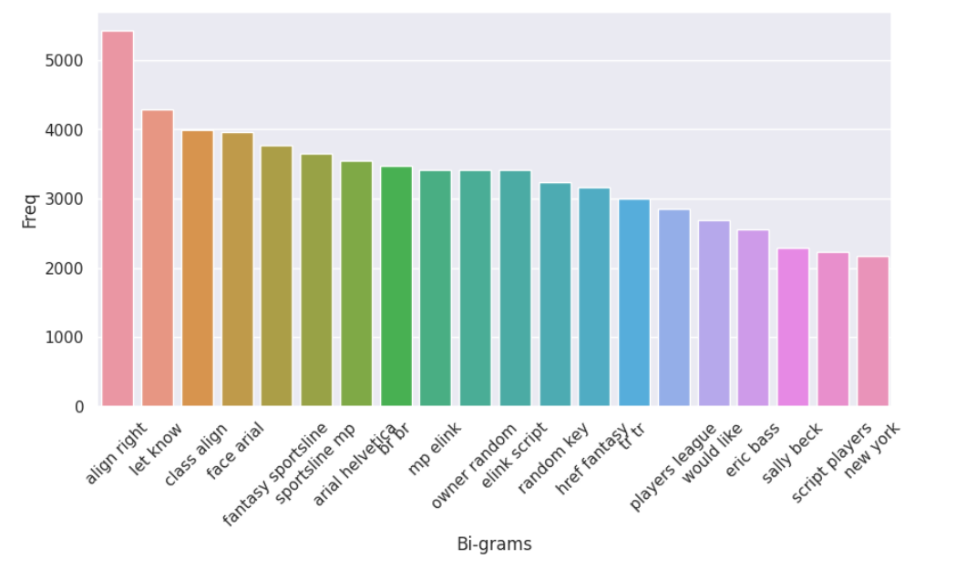
Bi-Gram Plot
A bigram language model is a type of statistical language model that predicts the probability of a word in a sequence based on the previous word
06

Slide 20
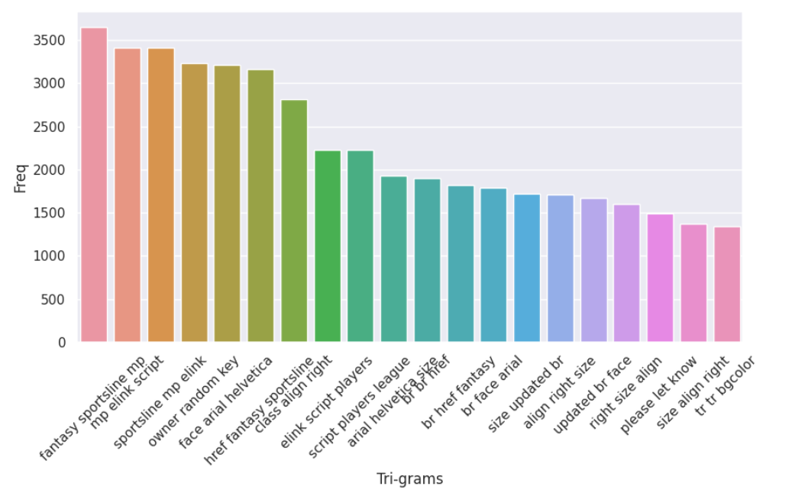
TRI-Gram Plot
06

Slide 21
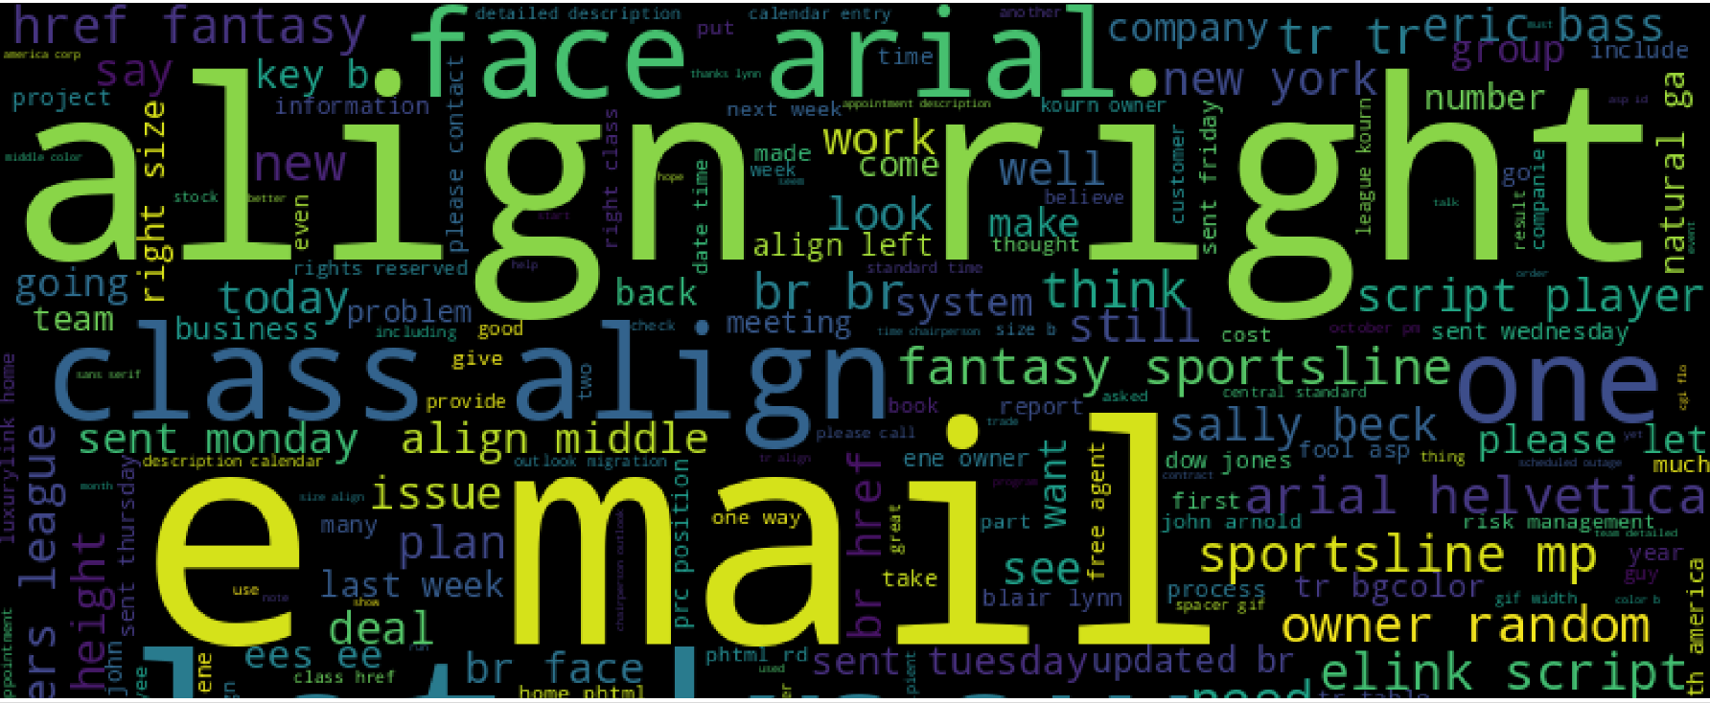
word cloud
06

Slide 22
BOW(word count matrix)
It's an algorithm that transforms the text into fixed-length vectors
from sklearn.feature_extraction.text import CountVectorizer
# Preparing email texts into bow word count matrix format
email_bow=CountVectorizer(analyzer=split_into_words).fit(emails.content)
# For all messages
all_emails_matrix=email_bow.transform(emails.content)
all_emails_matrix.shape
(24656, 85984)
06

Slide 23
TFIDF Tokenization
TF-IDF (Term Frequency - Inverse Document Frequency) is a handy algorithm that uses the frequency of
words to determine how relevant those words are to a given document.
from sklearn.feature_extraction.text import TfidfTransformer
# Learning Term weighting and normalizing on entire emails
tfidf_trans
former=TfidfTransformer().fit(all_emails_matrix)
# Preparing TFIDF for all emails
all_emails_tfidf=tfidf_transformer.transform(all_emails_matrix)
all_emails_tfidf.shape
(24656, 85984)
06

Slide 24
Label Encoding Class
LabelEncoder can be used to normalize labels. It can also be used to transform non-numerical labels (as long as they are hashable and comparable) to numerical labels.
from sklearn import preprocessing
# label_encoder object knows how to understand word labels
le = preprocessing.LabelEncoder()
emails['Class']= le.fit_transform(emails['Class'])
emails['Class'].value_counts()
1 23014
0 1642
Name: Class, dtype: int64
06

Slide 25
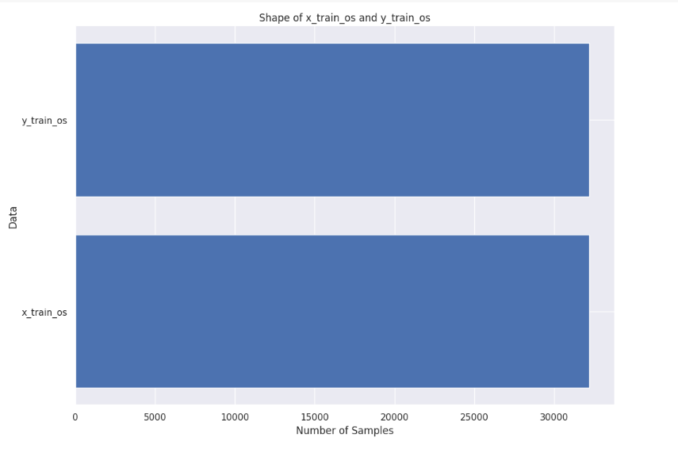
Data Balancing
OverSampling
# 1. Oversampling
from imblearn.over_sampling import SMOTE
oversample = SMOTE(random_state=42)
# transform the dataset
x_train_os,y_train_os=oversample.fit_resample(x_train,y_train)
x_train_os.shape,y_train_os.shape
((32190, 85984), (32190,))
06

Slide 26
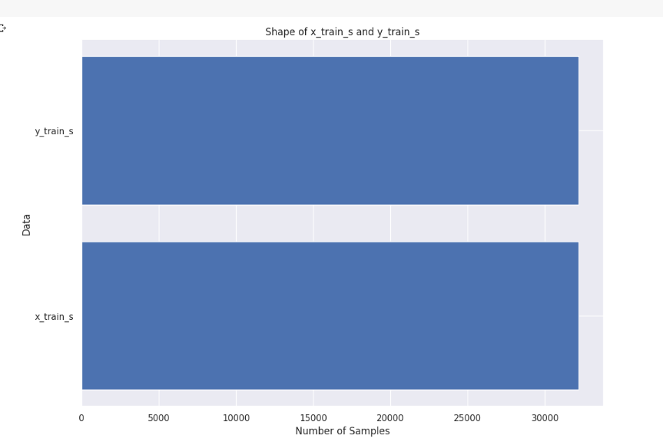
Data Balancing
2. Undersampling
# 2. Undersampling
from imblearn.under_sampling import RandomUnderSampler
undersample=RandomUnderSampler(random_state=42)
# transform the dataset
x_train_s,y_train_s=undersample.fit_resample(x_train_os,y_train_os)
x_train_s.shape,y_train_s.shape
((32190, 85984), (32190,))
06

Slide 27
Model Building
1. Multinomial Naive Bayes Classifier Algorithm.
2. Support Vector Machines Classifier Algorithm.
3. Logistic Regression Classifier Algorithm.
4. Decision Tree Classifier.
5. Random Forest Classifier.
6. ADABoost Classifier.
7. Extra Tree Classifier.
8. Gradient Boosting Classifier.
06

Slide 28
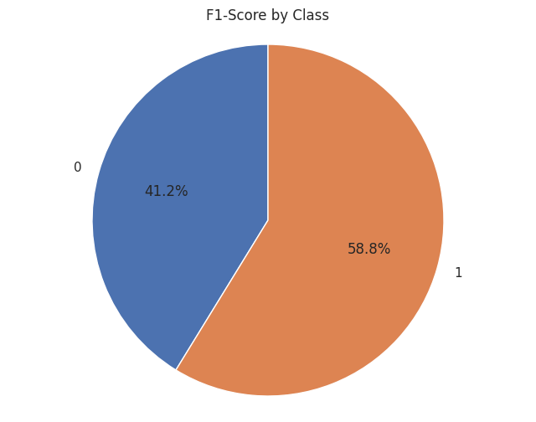
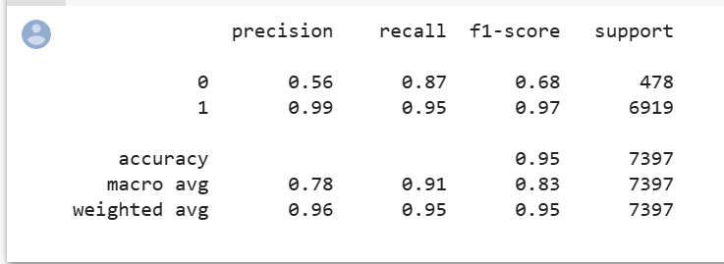
Model Classification Results
1. Multinomial Naive Bayes Classifier Algorithm.
accuracy_train_mnb: 0.9678782230506369
accuracy_test_mnb: 0.9475463025550899
06

Slide 29
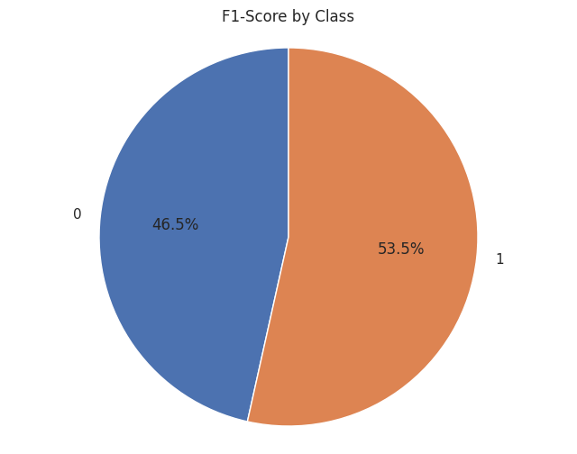
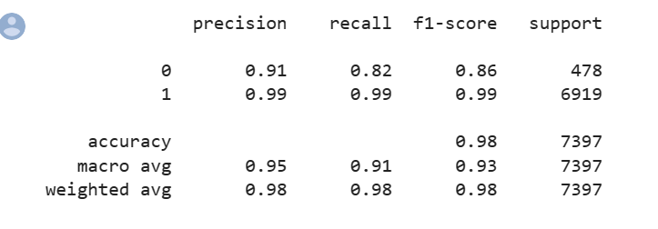
2. Support Vector Machines Classifier Algorithm.
accuracy_train_svm: 0.9983224603914259
accuracy_test_svm: 0.9831012572664594
06

Slide 30

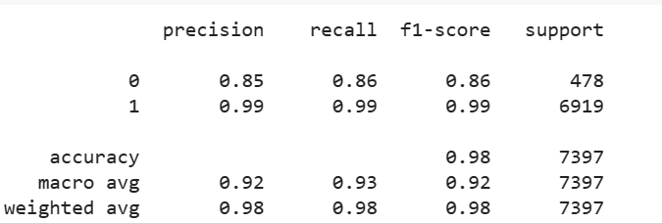
3.Logistic Regression Classifier Algorithm.
accuracy_train_log: 0.9949673811742777 accuracy_test_log: 0.9813437880221711
06

Slide 31
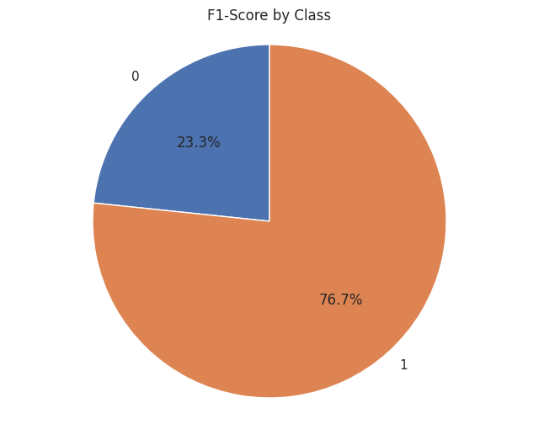
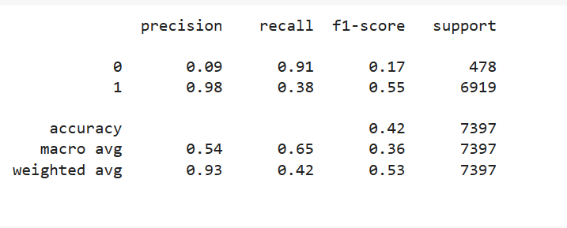
4. Decision Tree Classifier.
accuracy_train_dtc: 0.6562907735321528 accuracy_test_dtc: 0.41638502095444097
06

Slide 32
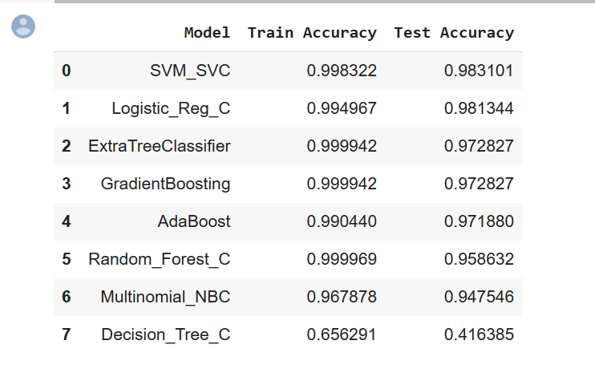
Comparison Of Models
After comparing all models it is found that the best fit model is SVM_SVC
06

Slide 33
E
Thank you

